Slide 1
Probabilistic Learning
Raghav R 185001119

Slide 2
Introduction
In Multi Layer Perceptron, information about what’s going on in the inner mechanisms isn't clear from just looking at the activations and the weights.
Hence we are going to look at models that are based on statistics and are therefore more transparent.
Meaning we can always extract the probabilities and understand what they are and the logical sequence of steps unlike arbitrary weights which have no obvious meaning.

Slide 3
Why Gaussian Mixture Model ?
A Bayes Classifier can be trained on data with target label with supervised learning by learning the probabilities from the labeled data.
For the same data with no target label requires unsupervised learning
We can't fit a single gaussian for all data as all won’t look gaussian overall.
A multi modal data can be classified by assigning a gaussian distribution for each class.

Slide 4
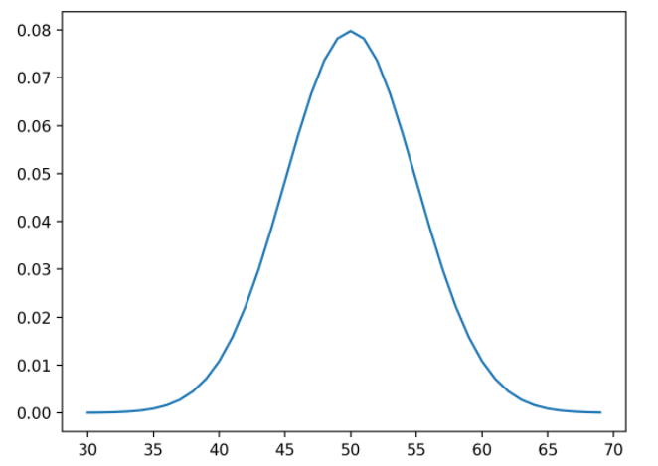
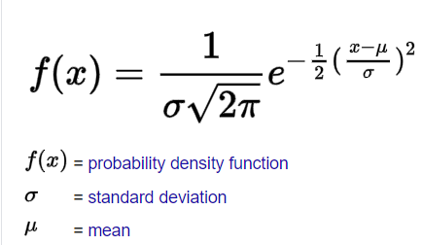
Gaussian Distribution
Gaussian Distribution also known as Normal Distribution
Represented as N(μ , σ²)
Notes:
Half on left half on right even distribution

Slide 5
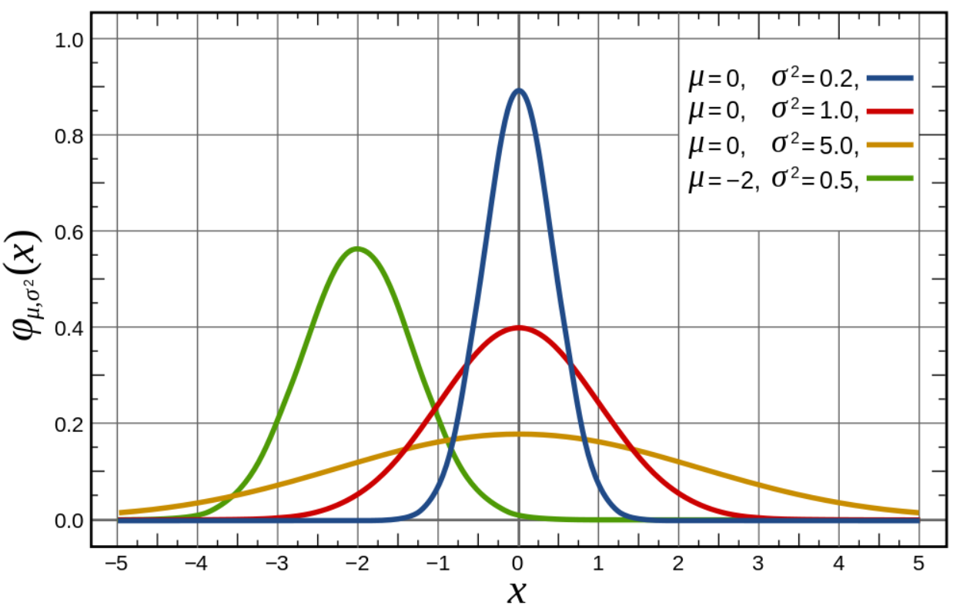
Gaussian Mixture Model

Slide 6
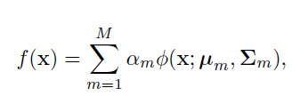





Gaussian Mixture Model
Gaussian Function
Mean
Covariance Matrix
Weights

Slide 7
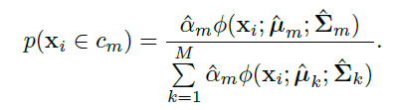
Gaussian Mixture Model
The Task is now to find the weights for this model.

Slide 8
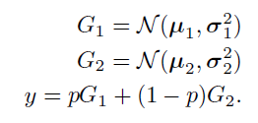
The Expectation-Maximisation (EM) Algorithm
Let us assume a simple gaussian mixture model made up of a combination of two gaussian mixtures.
Let p be the probability of picking first gaussian.
Let π be the probability distribution of p then Probability density is :

Slide 9
The Expectation-Maximisation (EM) Algorithm
Basic Idea of EM Algorithm
Introduce a hidden/latent variable such that its knowledge would simplify the maximization of the likelihood.
At each iteration:
E-step: Estimate the distribution of the hidden variable given the data and the current value of parameters.
M-step: Maximize the joint distribution of the data and the hidden variable

Slide 10
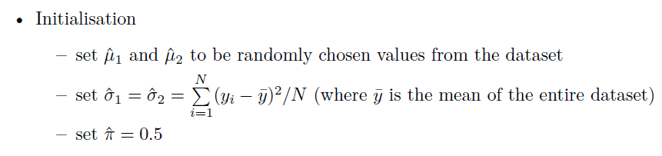
The Gaussian Mixture Model EM Algorithm

Slide 11
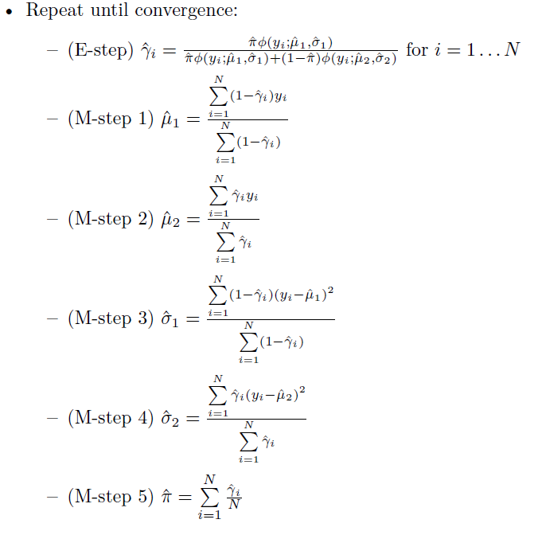

Slide 12
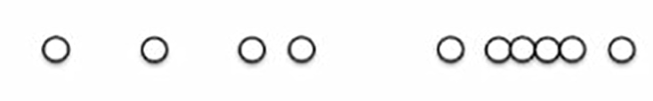
Visualization of the algorithm
Lets us take a simple example
A set of points in a single dimensional space.
Goal is to find Gaussian mixture model for this.

Slide 13
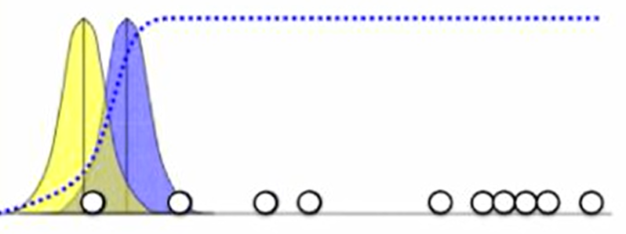

Slide 14
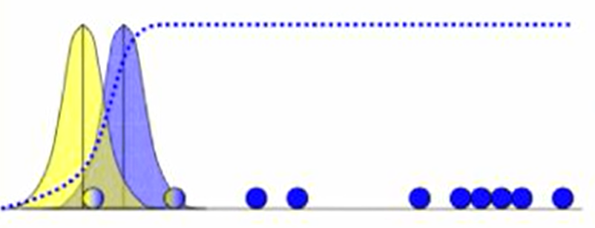

Slide 15
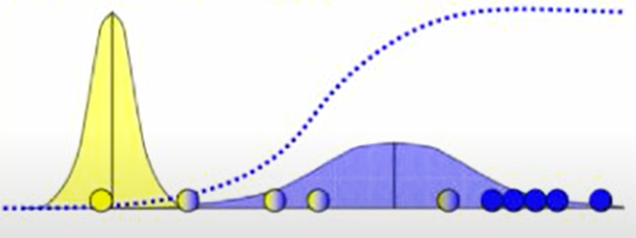

Slide 16
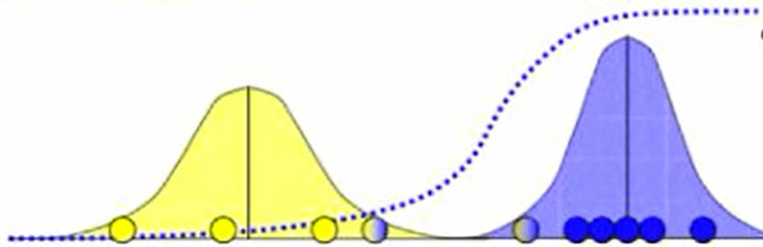

Slide 17
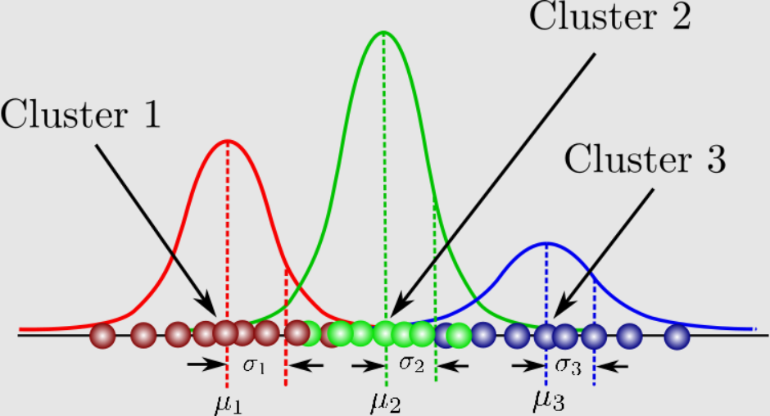
Gaussian Mixture Model
Notes:
There is, however, something we can do. If we know how many classes there are in the
data, then we can try to estimate the parameters for that many Gaussians, all at once. If
we don’t know, then we can try different numbers and see which one works best. We will
talk about this issue more for a different method (the k-means algorithm) in Section 14.1.
It is perfectly possible to use any other probability distribution instead of a Gaussian,
but Gaussians are by far the most common choice. Then the output for any particular
datapoint that is input to the algorithm will be the sum of the values expected by all of the
M Gaussians:

Slide 18
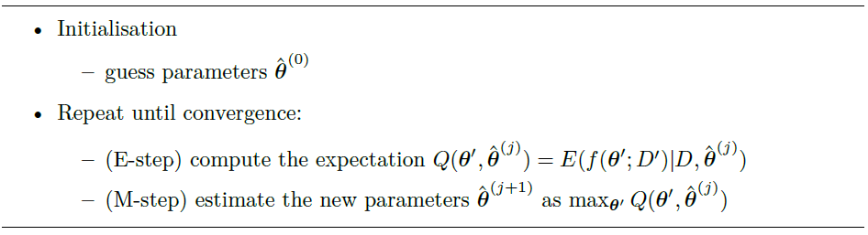
General Expectation-Maximisation (EM) Algorithm

Slide 19
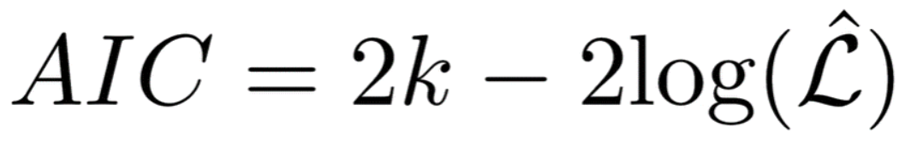
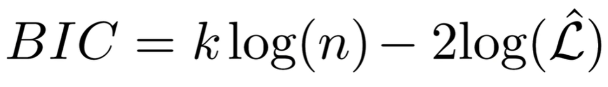
Information Criteria
It is possible to calculate a measure that tells us about how well we can expect a trained model to perform.
There are two such information criteria that are commonly used:
Aikake Information Criterium
Bayesian Information Criterium
k - number of Parameters
n - number of Training examples
L - largest likelihood of the model

Slide 20
NEAREST NEIGHBOUR METHODS
We have the datapoints positioned within input space, so we just need to work out which of the training data are close to it. This requires computing the distance to each datapoint in the training set, we can ignore the square root in the distance formula since we only want to know which points are the closest, not the actual distance We can then identify the k nearest neighbours to the test point, and then set the class of the test point to be the most common one out of those for the nearest neighbours.
The choice of k is not trivial. Make it too small and nearest neighbour methods are sensitive to noise, too large and the accuracy reduces as points that are too far away are considered.

Slide 21
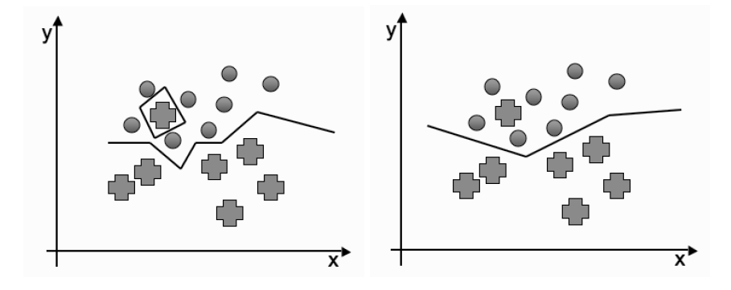
NEAREST NEIGHBOUR METHODS
Effects of changing the size of k on the decision boundary are

Slide 22
K nearest neighbours
This method suffers from the curse of dimensionality
The computational costs get higher as the number of dimensions grows.
As the number of dimensions increases, so the distance to other datapoints tends to increase.
Points that are relatively close in some dimensions, but a long way in others. This can be dealt with using adaptive nearest neighbour methods,
If more than one class is found in the closest points then class with maximum frequency found is assigned to it.

Slide 23

K nearest neighbours
Bias - Variance Decomposition
The way to interpret this is that when k is small, so that there are few neighbours considered, the model has flexibility and can represent the underlying model well, but that it makes mistakes (has high variance) because there is relatively little data. As k increases,the variance decreases, but at the cost of less flexibility and so more bias.

Slide 24
Nearest Neighbour Smoothing
Nearest neighbour methods can also be used for regression by returning the average value of the neighbours to a point as the new value.
This can be achieved by using Kernel smoothers.
Kernels are designed to give more weight to points that are closer to the current input, with the weights decreasing smoothly to zero as they pass out of the range of the current input, with the range specified by a parameter .

Slide 25


Kernels
Epanechnikov quadratic kernel:
Tricube Kernel:

Slide 26
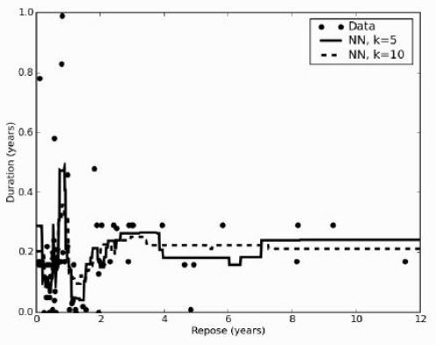
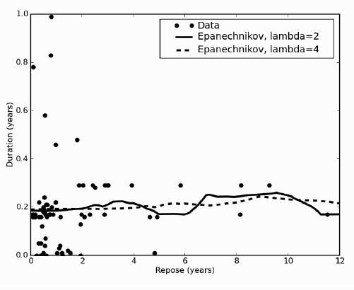
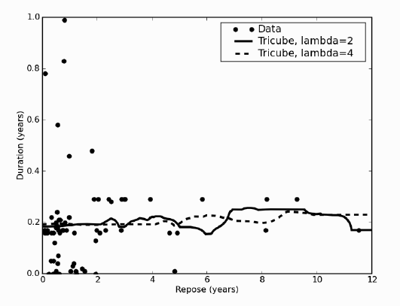
Nearest Neighbour Smoothing

Slide 27
KD-Tree
For effective computation of distance between all pairs of points
Computation of distance between all pairs of points is very expensive.
The computational overhead can be reduced using a efficient data structure.
The data structure of choice is KD-Tree.
The idea behind KD-tree is to create a binary tree by choosing one dimension at a time to split into two, and placing the line through the median of the point coordinates of that dimension.

Slide 28
KD Tree example
Suppose that we had seven two-dimensional points to make a tree from:
(5, 4), (1, 6), (6, 1), (7, 5), (2, 7), (2, 2), (5, 8)
The algorithm will pick the first x-coordinate to split on initially and the median point here is 5. So the split is through x=5.
Now the data is split into two and the median y-coordinate is found for data points on the left and right of the median line. This process is repeated till all points are added to the tree.

Slide 29
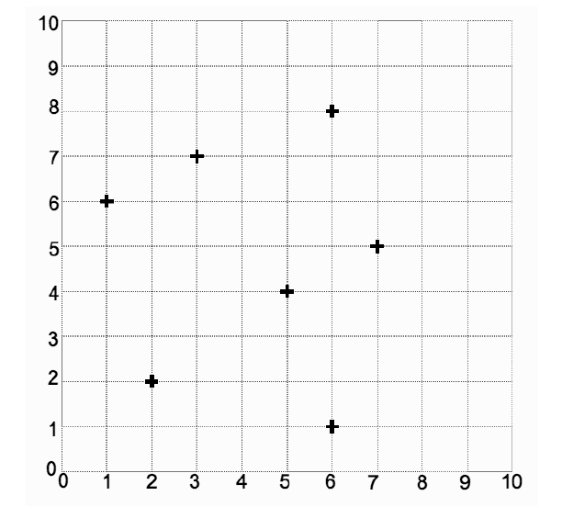
KD Tree example

Slide 30
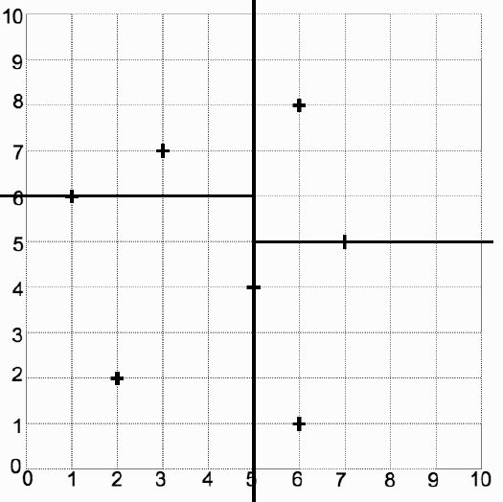
KD Tree example

Slide 31
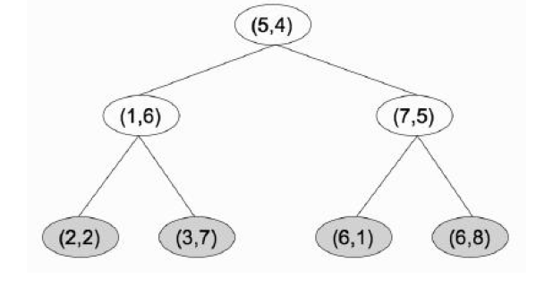
KD Tree example

Slide 32
KD Tree nearest neighbour
Searching for a nearest neighbour in a k-d tree proceeds as follows:
Starting with the root node, the algorithm moves down the tree recursively, in the same way that it would if the search point were being inserted (i.e. it goes left or right depending on whether the point is lesser than or greater than the current node in the split dimension).
Once the algorithm reaches a leaf node, it checks that node point and if the distance is better, that node point is saved as the "current best".

Slide 33
KD Tree nearest neighbour
3.The algorithm unwinds the recursion of the tree, performing the following steps at each node:
If the current node is closer than the current best, then it becomes the current best.
The algorithm checks whether there could be any points on the other side of the splitting plane that are closer to the search point than the current best by creating a radius of best distance.
If the radius crosses the plane, there could be nearer points on the other side of the plane, so the algorithm must move down the other branch of the tree from the current node looking for closer points, following the same recursive process as the entire search.
If the radius doesn't intersect the splitting plane, then the algorithm continues walking up the tree, and the entire branch on the other side of that node is eliminated.
4. When the algorithm finishes this process for the root node, then the search is complete.

Slide 34
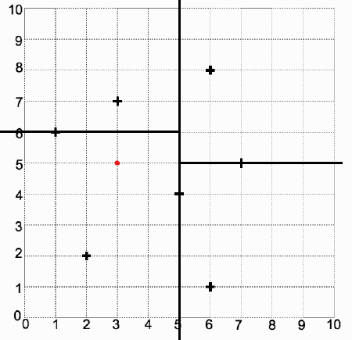
KD Tree nearest neighbour
Let new test point be (3,5)

Slide 35


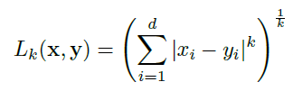
Distance Metrics
Euclidean Distance -
Manhattan Distance -
Minkowski Metric -

Slide 36
Minkowski metric
If we put k=1 then we get Manhattan distance formula
If we put k=2 then we get Euclidean distance formula
This is why Manhattan distance metric is referred to as L1 norm and
Euclidean distance metric is referred to as L2 norm

